Slide 1
Measuring Planet Mass, Radius, and Density
Group 5
Dax Begeny, Omar Kotrach, Matthew Williard and Gregory Costa

Slide 2
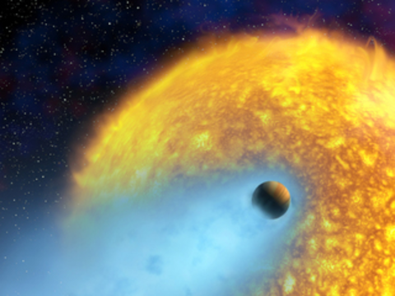
Introduction
-Different detection methods
-HD-209 458 b, also known as Osiris
-Calculating mass, radius, density
Notes:
-HD 209 458 b (also known as Osiris). HD 209 458 b is located roughly 49 parsecs away, orbiting HD 209458 in the Pegasus constellation
-This is one of the first planets to have had its atmospheric evaporation observed, as it is a hot-jupiter orbiting very close to its host star.

Slide 3
Motivation
NEA
Comparison
Learn how to obtain data
Where does HD 209 458 b sits in comparison to other exoplanets of similar radii and mass
Exoplanets
M-R Relationship
Better understand their properties
Where does HD 209 458 b sits on the mass-radius relation found in Chen and Kipping (2016)

Slide 4
Methods
Step 02
Step 04
Determine the radius of planet
Determine mass of HD 209 458 b
Step 01
Step 03
Step 05
Determine the transit depth
Determine the semi-major axis and period
Determine the Density of HD 209 458 b

Slide 5
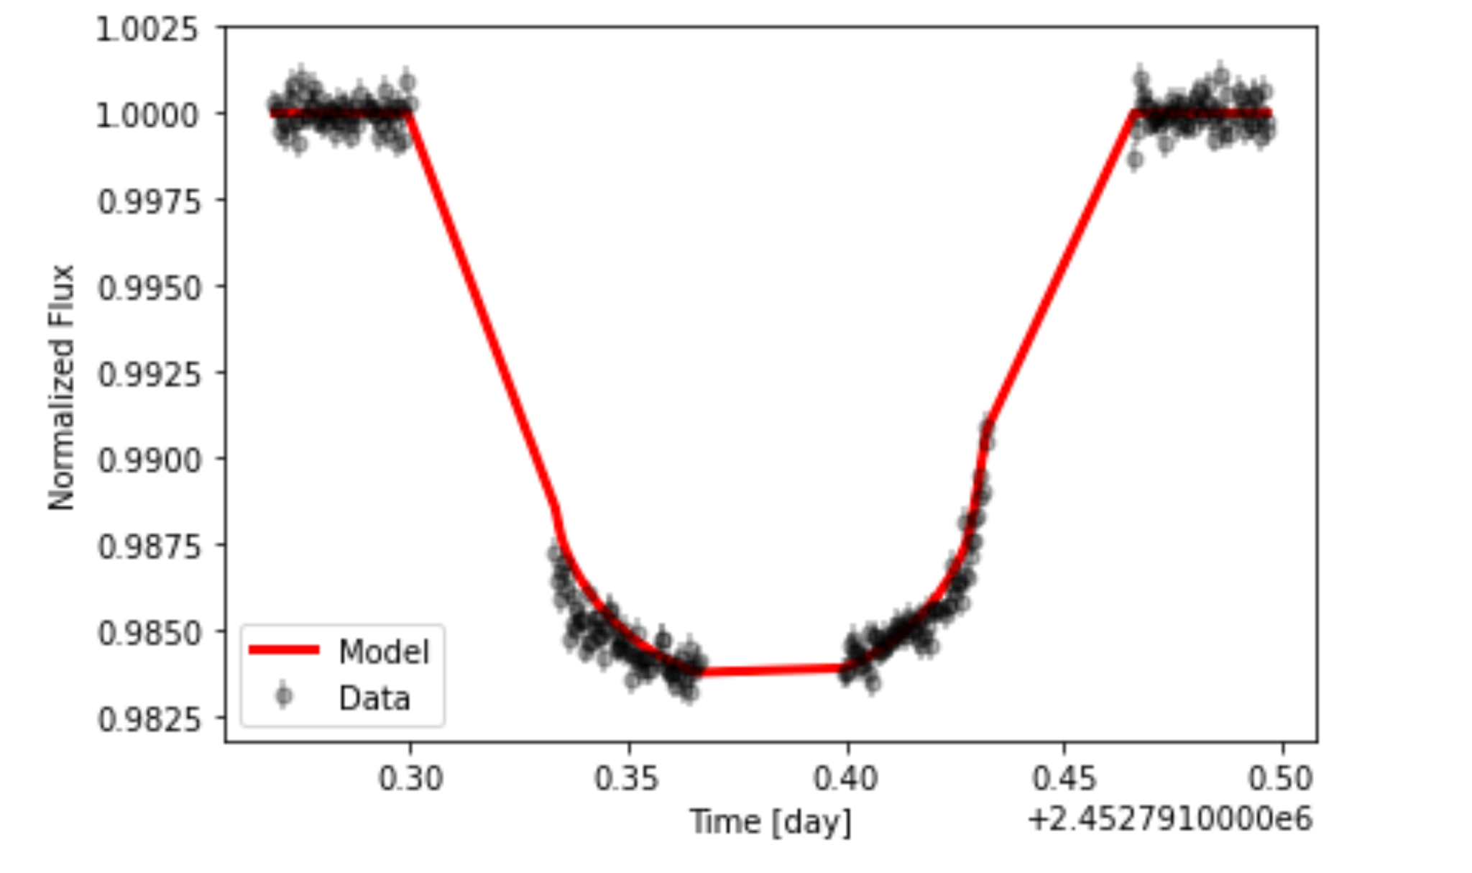
2.1
To determine the radius of HD 209 458 b, the distance to and radius the host star, the depth of the transit need to be known.
d = 10^{.2(m-M+5-A)}
𝛅 = 2 arctan(R*/d)
f = R*²/R_{p}²
Figure 1

Slide 6
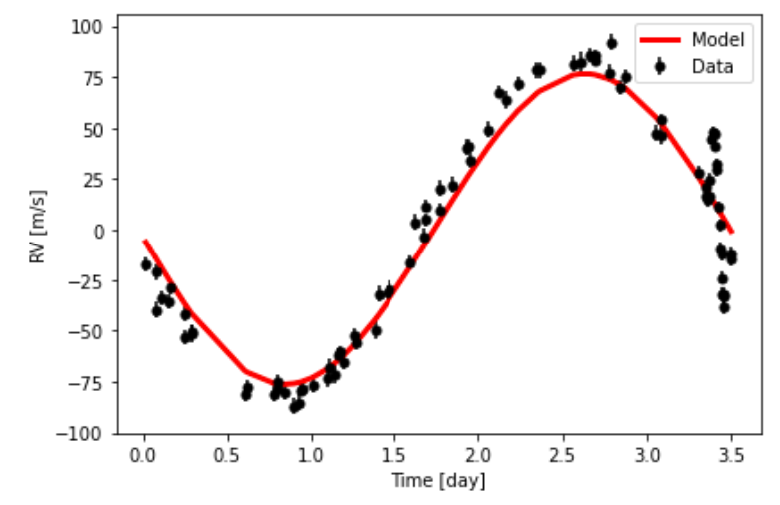
2.2
To determine the mass of HD 209 458 b, the host star’s mass, velocity, period, and the planet’s semi-major axis need to be known.
a = (GP²M*/4π²)^{1/3}
M_{p} = KM*^{3/2}(a/G)^{1/2}
Figure 2

Slide 7
2.3
To determine the density of HD 209 458 b, the mass of the planet is divided by its volume
⍴ = 3m_{p}/4πR_{p}³
2.4
To determine the uncertainties of the mass radius, and density, the uncertainties of former calculations were propagated

Slide 8
Results

Slide 9
3.1 The Radius of HD 209 458 b
R* = 1.2 ± .06 R_{Sun}
f = .175
R_{p} = 9.898 ± .502 * 10⁷ m
Figure 1

Slide 10
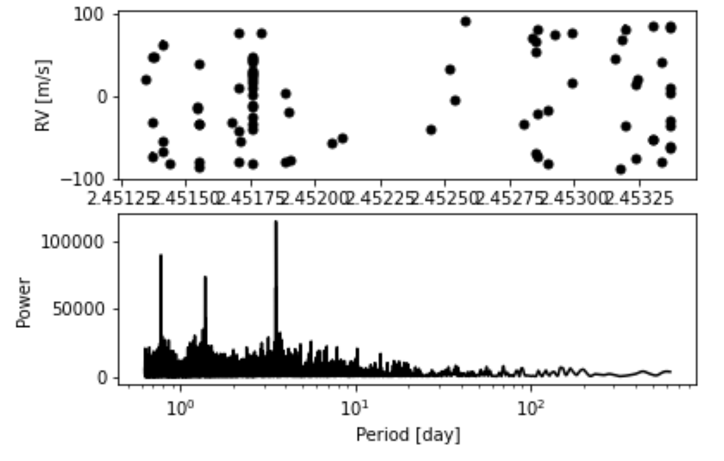
3.2 The Mass of HD 209 458 b
For finding the period, the Lomb-Scargle periodogram was applied. This tests the significance of weak periodic signals with uneven sampling.
The resulting period was: 3.525 Days.
Figure 3

Slide 11
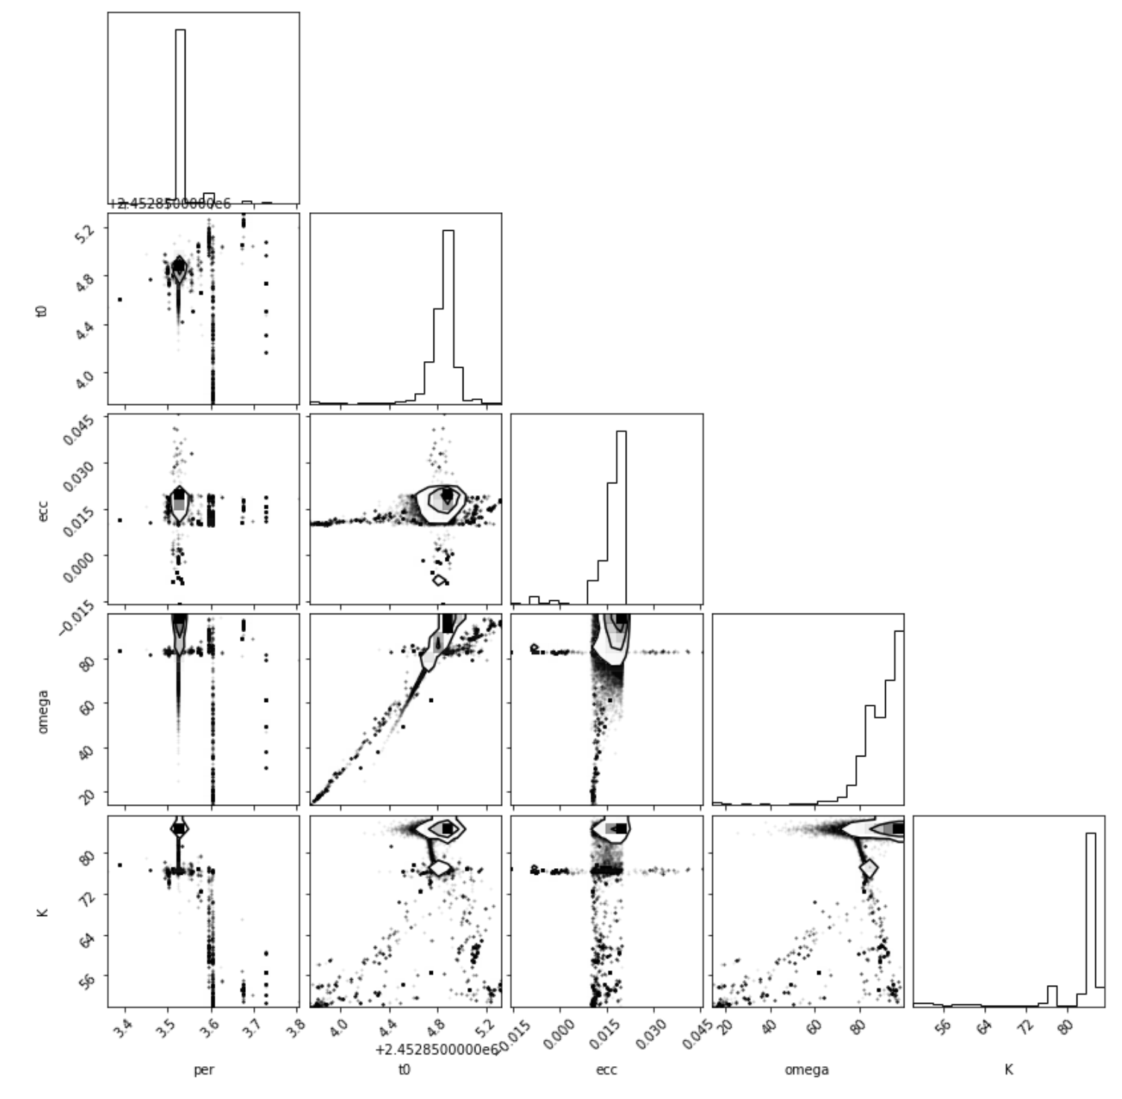
Using Emcee, K was determined to be around 86 m/s. Emcee is an ensemble sampler that efficiently samples the parameter space
With this information, the mass of HD 209 458 b can be determined.
M* = 1.15 ± .08 M_{Sun}
M_{p} = 1.25 ± .15 * 10²⁷ kg
Figure 4

Slide 12
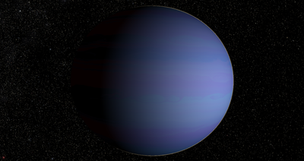
3.3 The Density of HD 209 458 b
When the mass is divided by the volume of the planet, the following density is obtained.
⍴ = 310.94 ± .04 kg/m³

Slide 13
Discussion
Jupiter |  | Radius | 1R_{Jupiter}
 |  | Mass | 1M_{Jupiter}
 |  | Density | 1326 kg/m³
Osiris |  | Radius | 1.40 ± .07 R_{Jupiter}
 |  | Mass | 0.71 ± .08 M_{Jupiter}
 |  | Density | 310.94 ± 41.36 kg/m³
https://solarsystem.nasa.gov/planet-compare/
Notes:
Less massive than Jupiter
Larger radius than Jupiter
Significantly less dense than Jupiter
This implies that larger mass does not mean larger radius. It seems that more gas collapses down into a smaller radius and is more dense.

Slide 14
4.1 Comparison to other exoplanets
Used NAE exoplanet archive
Selected exoplanets with similar radii (0.01-2 R_{jupiter}) and mass (0.2 to 1.2 M_{jupiter})
Sample of 814 Planets
Plot Mass against Radius, and Mass against Density
Notes:
We compare Osiris against other exoplanets and check if this trend is consistent with other exoplanets
Used the NAE database to get a collection of exoplanets. Restrict the selection to be of similar size and mass to osiris. We use the same methodologies used on osiris on all the exoplanets selected.
Then we plot the results

Slide 15
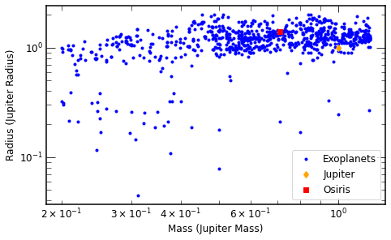
Mass vs Radius
Figure 5
Notes:
Osiris is in the middle of a dense cluster of other exoplanets. It seems standard in its mass and radius.
The overall trend of mass against radius seems relatively flat, as the mass of exoplanets increase the radius of exoplanets do not really increase
Osiris fits the parameters of other exoplanets

Slide 16
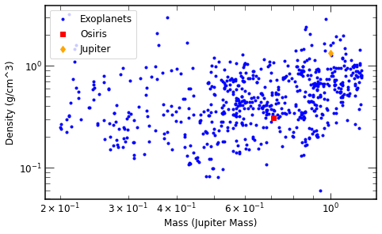
Mass vs Density
Figure 6
Notes:
In the plot of mass against density osiris appears standard, within a cluster of other exoplanets.
The trend of mass against density is less defined compared to mass and radius, but focusing on the large cluster of exoplanets on the higher mass end appears to have a more positive correlation.

Slide 17

4.1.2 Trends of the data
Mass and radius have a relatively flat relationship
Mass and density have a positive relationship
As mass increases, radius does not increase very quickly
As planetary mass increases, extra gas compresses down
Notes:
Mass and radius appear to have a relatively flat relationship while mass and density appear to have a more positive relationship. As the mass increases the radius does not really increase very much where as the density appears to increase. This is consistent with the comparison of Osiris against jupiter. A possible explanation for this trend is that as more gas mass is added to a planet, the greater gravity causes the gas to collapse in on itself and crush down, causing the radius to not increase as mass increases, but the crushing and increased mass over the same area leads to an increase in density.

Slide 18
M-R Relationship from Chen & Kipping (2016)
A model to forecast the mass/radius of an astronomical object based on a measurement of the other
R = C (M)^{s}
S = -.044 given by power-law index of Jovian worlds
C = 14.43
Plugging our mass gives us a radius of 1.01 R_{Jupiter}
This is 27.85% different from our results
Notes:
R and M represent the radius and mass, respectively
The parameters C and S are determined by the plantes’s properties.
We used the values of Jupiter to determine the value of C

Slide 19
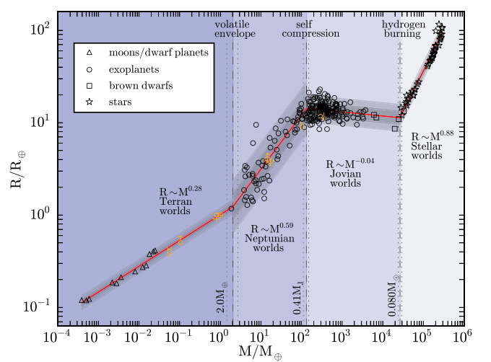
Osiris

Slide 20
Conclusion
Radius
R = 1.4 ± .07 R_{Jupiter}
Mass
M = 0.71 ± .08 M_{Jupiter}
Osiris
A hot-jupiter orbiting very close to its host star
Density
⍴ = 310.94 ± .04 kg/m³
Notes:
The project analyzed an exoplanet’s radial velocity and transit data
The planet’s radius was 1.4, mass 0.71 and density 310.94
The planet’s properties are consistent with current models of exoplanet
The project provided an opportunity to practice data analysis and uncertainty propagation

